Slide 1
Big Mountain Ski Resort:
Pricing Strategy
August 2020
Grace Tang
(Springboard DSC Guided Capstone)

Slide 2
Problem: Ticket Price
Our goal is to increase revenue by $1.696M this season.
The newly installed chairlift will increase operating costs by $1.54M this season.
Investors want to keep the profit margin at 9.2%
Increasing adult chairlift ticket prices will increase revenue.
Given the features available at Big Mountain Resort, what price should management set for adult chairlift tickets, in order to increase revenue this season?

Slide 3
Recommendation and key findings
Recommendation: Increase Ticket Price by $2.83 or More.
Increasing the ticket price by $0.97 will cover the new operating costs and maintain profit margin of 9.2%.
But increasing the ticket price by $2.83 or more will more accurately reflect Big Mountain’s market share, based on its offered features.
Key findings:
Big Mountain adult day ticket price is currently $81.
Big Mountain adult day ticket price is valued at $94.22 ± $10.39 ($83.83 to $104.61).
The lowest estimate, $83.83, is still higher than the current $81 ticket price.

Slide 4
Modeling: Setup
Models used:
Linear Regression
Random Forest
Data used:
277 ski resorts in the US, including Big Mountain.
Assumptions made:
The other 276 ski resorts are pricing their tickets accurately.
The ski resort market behaves as a free market.

Slide 5
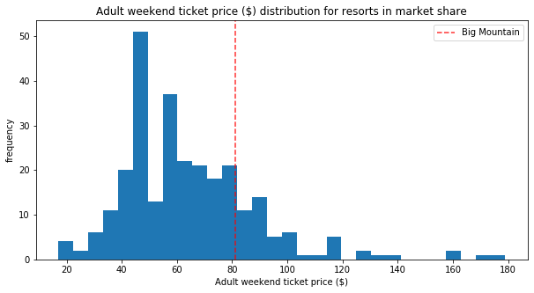
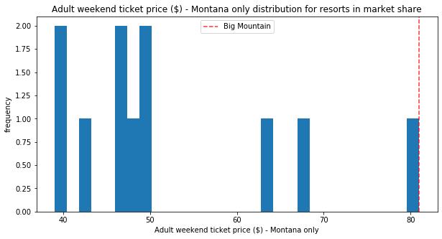
Modeling: Ticket Price Comparison
Big Mountain is the most expensive resort in Montana.

Slide 6
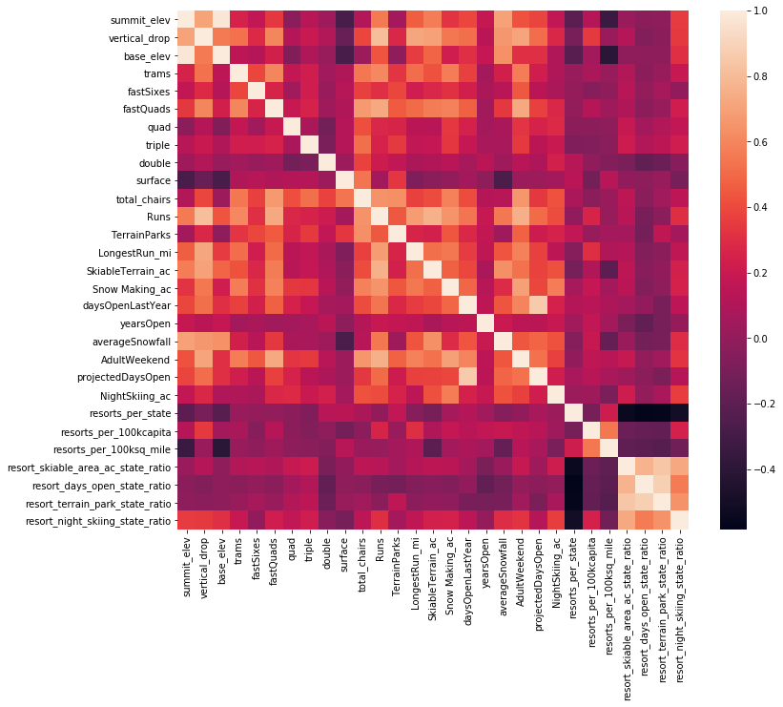
At a Glance: Heatmap
Lighter squares indicate stronger correlation.
“AdultWeekend” ticket price correlates with:
fastQuads
Runs
Snow Making_ac
total_chairs

Slide 7
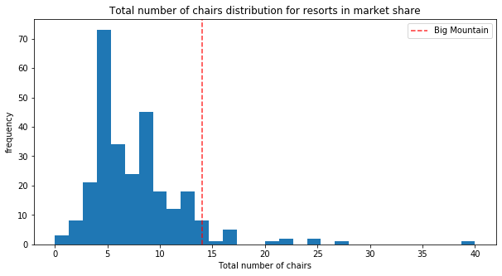
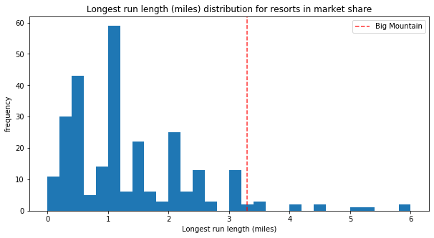
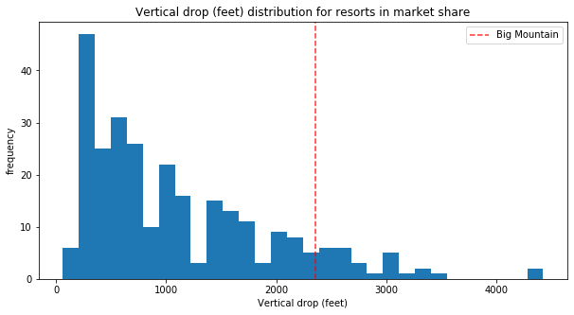
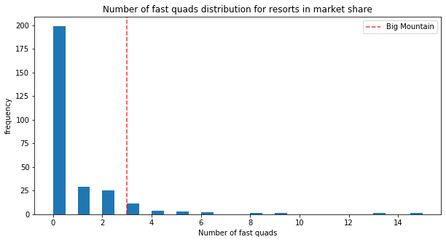
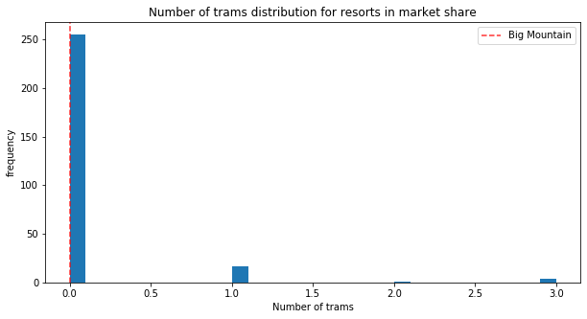
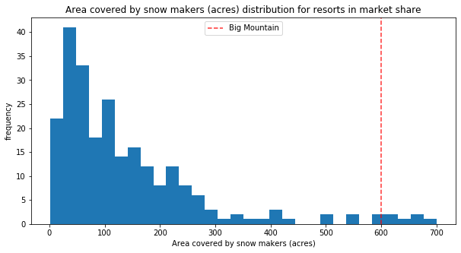
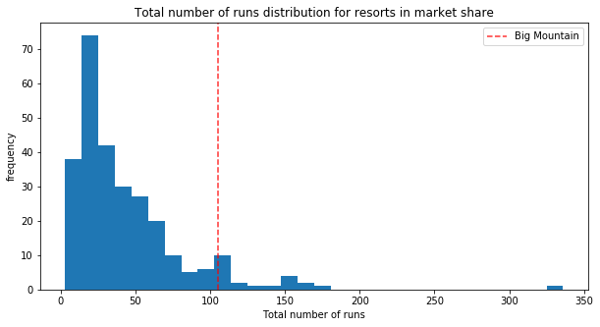
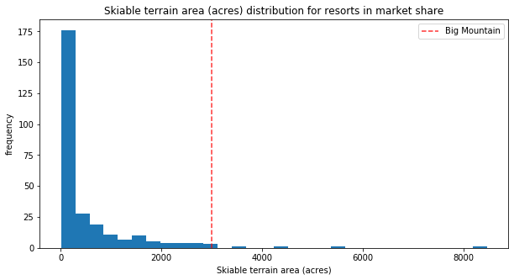
Modeling:
The 8 Features
Our models found 8 important features in determining ticket price.
Big Mountain (the red line) is fairly high on most of these league charts.

Slide 8
Conclusion
Big Mountain is the most expensive ski resort in Montana, at $81 per adult day ticket.
The price is justified: Big Mountain performs well in the 8 features important to determining ticket price.
The model values ticket price between $83.83 to $104.61
The lowest estimate, $83.83, is still higher than the current $81 ticket.
Recommendation: increase ticket price by $2.83 or more.

